Slide 1




4 – Merge Conflicts
https://www.youtube.com/watch?v=Tyd0FO0tko8
Images from:
https://git-scm.com/downloads/logos
https://github.com/logos
Notes:
BEFORE CLASS:
- Need to merge the conflict branch right before class.
- This branch will change all of the lines that are touched by the round2 issues.
- That will change everyone’s PR from
- can be merged automatically
- to contains conflicts.
In the activity due today you
-addressed another issue
- adding a link to the README
- made a pull request for that change to the upstream.
Today we’ll do a quick overview of how you got there.
Then we will see
- What can happen when multiple changes conflict.
- We have been careful to this point to ensure that each change was independent.
- So your change did not affect anyone else's
- And theirs did not affect yours.
- But clearly with multiple people working asynchronously in a distributed community
- it is possible that concurrent changes
- by different people
- will interact in was that conflict.
- When we try to bring those changes together
- They create what is called a merge conflict.

Slide 2
Our Current State
How did we
get here?
Commit
Pull Request
Synch
Switch
Branch
Push
Stage
Edit
Notes:
This is where things stand after you have completed the prior homework.
How did we get here?
- Discuss with your neighbors…
- Place this list of terms into a plausible order.
Build the list on the board:
1. Synch
2. Branch
3. Switch
4. Edit
5. Stage
6. Commit
7. Push
8. Pull request
Note that all developers might be doing the same thing.

Slide 3
Our Current State
Demo: Look at the Pull Requests on GitHub
Notes:
This is where you were when you made your PR.
- When you finished the previous homework your PR should have said
- can be merged automatically.
- From this picture that should make sense
- your blue commit (and the fuchsia and lime ones too)
- all can be applied directly on the green one
- which is still at the head of the main branch.
But if we look at your PR’s now…
- They will say “This branch has conflicts that must be resolved”
Why/How did that happen?
- next slide.

Slide 4
Upstream Changes
✓
Why is there now a conflict?
Notes:
This is the state of the world now…
- What has happened?
- Maintainers (me) merged a pull request into main
- the Fuchsia commit was added.
Ask: Why do you think it created conflict?
- Just get at the idea that the blue (or lime) commit
- must have changed the same parts of the repo
- i.e. the same area of a file.
- Don’t need to be too precise here.
Truth:
- I merged a commit that changed
- all four lines that were affected by the round 2 issues.
- so that commit will create a merge conflict for everyone

Slide 5
Merging Branches: Common Ancestors
Old MacDonald had a farm
And on that farm, he had a pig
With an oink oink here
And an oink oink there
Old MacDonald had a farm
And on that farm, he had a duck
With a quack quack here
And a quack quack there
Old MacDonald had a farm
And on that farm, he had a cow
With a moo moo here
And a moo moo there
Old MacDonald had a farm
And on that farm, he had a duck
With a quack quack here
And a quack quack there
Old MacDonald had a farm
And on that farm, he had a cow
With a moo moo here
And a moo moo there
Old MacDonald had a farm
And on that farm, he had a goat
With a bahh bahh here
And a bahh bahh there
Feature Branch
Best Common Ancestor
Main Branch
Notes:
Let’s have a little closer look at the merge process
- to understand why there were no conflicts last time
- why there are conflicts this time
- and give us a foundation for understanding how we resolve them.
Here we want to merge (or blend) the changes in
- the feature branch – blue commit
- the upstream main branch – fuchsia commit
The way this works is that git uses the history to find the best common ancestor
- The best common ancestor is the most recent shared ancestor.
Ask:
- Which commits here are common ancestors?
- red, yellow, green
- Which one is the best (i.e. most recent)?
- green

Slide 6
Merging Branches: Identifing Changes
Non-conflicting changes can be merged automatically.
Old MacDonald had a farm
And on that farm, he had a pig
With an oink oink here
And an oink oink there
Old MacDonald had a farm
And on that farm, he had a duck
With a quack quack here
And a quack quack there
Old MacDonald had a farm
And on that farm, he had a cow
With a moo moo here
And a moo moo there
Old MacDonald had a farm
And on that farm, he had a duck
With a quack quack here
And a quack quack there
Old MacDonald had a farm
And on that farm, he had a cow
With a moo moo here
And a moo moo there
Old MacDonald had a farm
And on that farm, he had a goat
With a bahh bahh here
And a bahh bahh there
Feature Branch
Best Common Ancestor
Main Branch
Notes:
Next
- git will compare the branches to the best common ancestor
- and identify the changes that have occurred in each
The changes can be:
- Non-conflicting
- Conflicting
Ask:
- Do you think the current changes are conflicting or non-conflicting?
- why?
Ask:
- What would be conflicting changes?
- if blue had changed duck or quack.
- if fuchsia had changed cow or moo
The idea of conflicting and non-conflicting changes is
- intuitively simple
- roughly… not on the same line
- much more complicated in practice
- we will not go into it…
- there is a link or two in the activity if you are interested in the details
- git’s recursive merge strategy (default)
- https://git-scm.com/docs/merge-strategies
Non-conflicting changes can be merged automatically.
- The managers of the upstream will do this
- It is what we saw last week.

Slide 7
Merge Commits
A
merge commit adds or blends changes from two parents.
Time
main
hasPig
Old MacDonald had a farm
And on that farm, he had a pig
With an oink oink here
And an oink oink there
Old MacDonald had a farm
And on that farm, he had a duck
With a quack quack here
And a quack quack there
Old MacDonald had a farm
And on that farm, he had a pig
With an oink oink here
And an oink oink there
Old MacDonald had a farm
And on that farm, he had a goat
With a bahh bahh here
And a bahh bahh there
Old MacDonald had a farm
And on that farm, he had a cow
With a moo moo here
And a moo moo there
Old MacDonald had a farm
And on that farm, he had a goat
With a bahh bahh here
And a bahh bahh there
7
Feature Branch
Merged Result
Main Branch
7
Notes:
When two branches are merged
- A merge commit is added to the target branch
- In this case we are showing an automatic merge
- of a feature branch into the main branch.
When changes don’t conflict
- and the merge happens automatically
- the merge commit will just add the changes from the feature branch
But, as we will see if the changes conflict
- then the merge commit may
- pick one or the other
- or blend the changes
Having a merge commit makes it clear where the changes came from.
- part of the history.
- preserves the fact that a branch was merged
- where the branch came from
- what commits it contained
- when it was merged
NOTE: This probably belonged in the last class.
- Move it there next time with the Merge to Upstream part.
NOTE:
- This also skirts the issue of multiple commits on the branch.
- I think that is okay for now.
- it is fully compatible with a squash and merge approach.
- I think the thing to do would be to add more nuance later if desired.
- generalize to include
- squash and merge
- merge
- rebase

Slide 8
Merge Conflicts
Merge Conflicts must be resolved manually.
Old MacDonald had a farm
And on that farm, he had a cow
With a moo moo here
And a moo moo there
Old MacDonald had a farm
And on that farm, he had a piglet
With an oink oink here
And an oink oink there
Old MacDonald had a farm
And on that farm, he had a cow
With a moo moo here
And a moo moo there
Old MacDonald had a farm
And on that farm, he had a duck
With a quack quack here
And a quack quack there
Old MacDonald had a farm
And on that farm, he had a cow
With a moo moo here
And a moo moo there
Old MacDonald had a farm
And on that farm, he had a pig
With a oink oink here
And a oink oink there
Feature Branch
Best Common Ancestor
Main Branch
Notes:
A merge conflict occurs when
- There is no way for git to know what the intended result is.
- should it be a pig or a piglet?
- should it be an oink oink or a oink oink?
- We may know
- but git cannot know.
- So this must be resolved manually.
The managers could take the time to do this
- But
- they are busy people
- and you are the expert on the changes you are adding
- So
- usually you will be asked to fix this.
- That is also compatible with the idea that
- The current main branch should be the starting point for all new work.
- Basically, it is your responsibility to ensure that your changes are compatible with the current main.

Slide 9
Synch with Upstream Main
1. switch to main
2. pull from upstream
3. push to origin
Notes:
In order to resolve the merge conflict you will need to
- Get the updates to the upstream main
- into your local repo
- also good idea to push to origin
- just to keep everything in synch.
Then you will resolve the merge conflict
- in your local repo
- on your machine
- then push the result up to your origin

Slide 10
Resolving a Merge Conflict
Upstream changes are merged from main into your feature branch.
Time
main
hasPig
Old MacDonald had a farm
And on that farm, he had a cow
With a moo moo here
And a moo moo there
Old MacDonald had a farm
And on that farm, he had a piglet
With an oink oink here
And an oink oink there
Old MacDonald had a farm
And on that farm, he had a cow
With a moo moo here
And a moo moo there
Old MacDonald had a farm
And on that farm, he had a pig
With an oink oink here
And an oink oink there
Old MacDonald had a farm
And on that farm, he had a cow
With a moo moo here
And a moo moo there
Old MacDonald had a farm
And on that farm, he had a pig
With a oink oink here
And a oink oink there
10
Feature Branch
Merged Result
Main Branch
10
Notes:
Now with the upstream changes in your local repo
You resolve the conflict by
- merging the changes
- from the main branch
- into your feature branch
For example here:
- pig is taken from main
- an oink oink is taken from your branch
- a blending of the two colors is used to indicate this.
Might seem backwards
- We want the changes in main
- Ask: Why not merge into the main branch?
- recall that we don’t ever merge into main
- we leave that to the maintainers
By doing the merge
- we have told git how we want that conflict to be resolved.
- So, the feature branch can now be merged automatically.
Can also now think of it this way:
- the changes in the blue/fuchsia commit
- can be applied after the changes in the fuchsia commit.
- without any conflict.

Slide 11
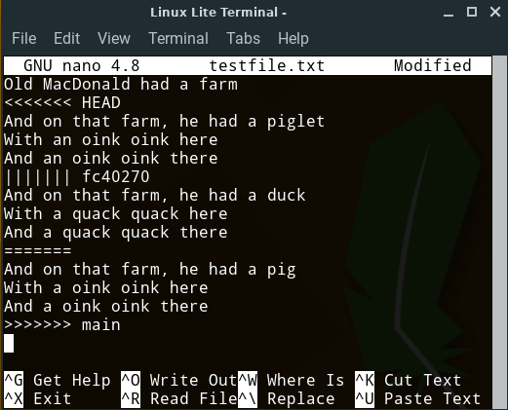
Raw Merge Conflicts
Feature
Branch
“Chevrons”
<<<<<<
>>>>>>
Best Common
Ancestor
main
Branch
Notes:
When a merge conflict occurs
- git will place text directly into the conflicting files
- to represent the conflict
Ask
- What do you think we are seeing here?
- the three versions of the conflicting content
- the feature branch
- the best common ancestor
- the main branch
The conflict is indicated by
- “Chevrons”
- Aligned V shapes
- Often on military uniforms to indicate rank
- also often used for directional road markings.
The other symbols
- ||||||| fc40270
- the SHA of the best common ancestor
- ======
- just a divider before the main branch.
You can simply edit the file:
- Open it in any editor you want
- Make everything between the chevrons look the way you want.
- Just edit it down to the correct blended version.
- Remove the chevrons
- Save and exit

Slide 12
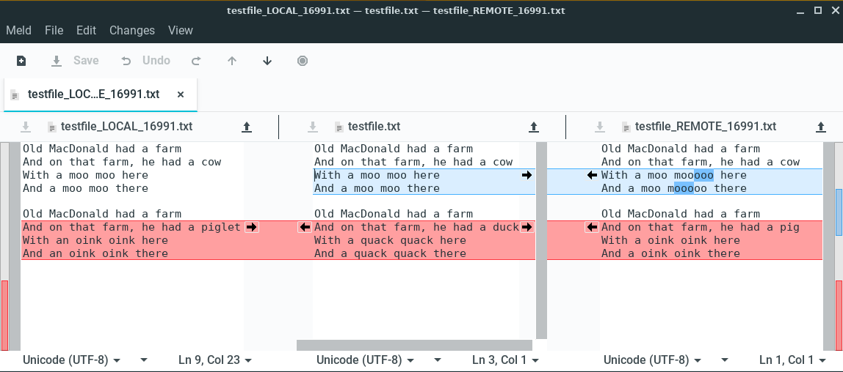
Using a Graphical Merge Tool (e.g. Meld)
Ancestor /
Result
Feature Branch
Main Branch
Notes:
The GUI merge tool will display the same information
In a way that makes it a little easier to work with.
Colors:
- red indicates conflicts
- blue indicates changes but not conflicting
Action:
- Goal is to make the middle pane into what you want
- click arrows
- edit directly
- Save
- Exit
Another nice thing about the GUI tool is if there are multiple conflicts
- the Up and Down arrows at the top
- will move you to the next or previous conflict.
Most IDE’s will have some sort of integrated merge tool.
- Atom, Eclipse, VisualSudio
- whatever you happen to use.
- They all display the same information
- Just in different ways.

Slide 13
Big Picture: Resolving a Merge Conflict
Notes:
Here we just have it all together.
- we already synchronized
- we switch to the feature branch
- perform the merge to resolve the conflict
- Note that this will mean that you have changed the local files!
- Edited them by hand
- or used a GUI tool
- So these changes need to be staged and committed.
- stage the changes
- commit the changes
- push the feature branch
- recall that this will automatically update the PR
- and now it will be able to be merged automatically.
This is where you will want to get to by the end of the activities for this topic.

Slide 14
Big Picture: The Whole Messy Thing
Notes:
No need to spend much time here.
If you can look at this and remember
- what each of the yellow terms means
- how it relates to the others
- sequence them into a workflow
Then you are in good shape.
- if not keep this handy
- review a little
- make more sense of it little by little.

Slide 15

Acknowledgments:
Slide Template From:
https://creativecommons.org/licenses/by/4.0/
Slide Content Licensed as:
https://creativecommons.org/licenses/by-nc/4.0/

